Slide 1
OptiKey modelling challenge
Ilan matityahu
Adir elfersy
Yair shalev
Nir alkalay
Katya denef
Software Modelling, JCE

Slide 2
Overview
Project Description
OptiKey System
Code Structure
Documentation
Stakeholders View on Main Features
Localization Activity Diagram
Design Metrics Application
Conclusions

Slide 3
Project Description
Objective
Analyze and document an open-source project on GitHub using SW modelling tools
Results
Open-source project OptiKey selected
Several modelling tools used to document the project:
Views
Activity diagram
Code analysis on design metrics

Slide 4
About OptiKey
OptiKey is an assistive on-screen keyboard
It’s designed to be used with an eye-tracking device to bring keyboard control, mouse control and speech to people with motor and speech limitations
Its goal is to challenge the outrageously expensive, unreliable and difficult to use AAC (alternative and augmentative communication) products on the market
Main features and challenges

Slide 5
OptiKey: Code Structure
Created by a single person (Julius Sweetland)
A lot of options for volunteering developers, e.g. enabling new languages
Fully GitHub driven and managed development process
Test units enabled in the system
Large number of contributions shows high ability for scalability and modular development

Slide 6
OptiKey: Docmentation
OptiKey Wiki describes functionality and user guidelines for a number of processes in a text
Listing exists for functions, keys, states, connections, windows states, keyboard functions to enable volunteers to understand the system structure
Development process is bug/issue driven
Qualities handling we added to the system
Modelling tools are hardly used
in the project

Slide 7
Stakeholders View
Link to GitHub
OptiKey is designed to be used with a low cost eye-tracking device to bring keyboard control helping people with motor limitation
It is also designed to be used with speech for people with speech limitations
Mouse control is available as well to be useful for all the people
OptiKey uses a Low cost certificate for Open Source projects from www.certum.eu, which is one of the main resources available for quick and low cost for a customers production key and certificate

Slide 8
Localization Activity Diagram
Link to GitHub
We created an Activity Diagram for building a localization
This feature was selected since it’s one of the most popular contributions
Here’s some feedback we received from the main developer

Slide 9
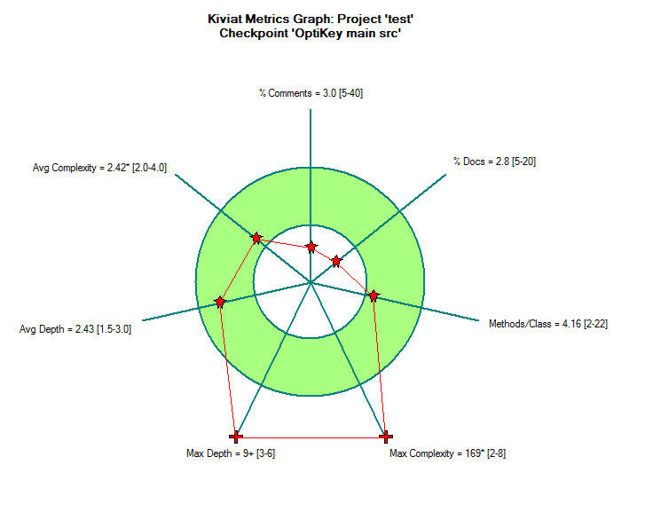
Design Metrics Application
We used code analyzer tool SourceMonitor
Link to GitHub
Main analysis:

Slide 10
Conclusions
What did we learn from the project? And the course?
Modelling is a language connecting between
developers of different modules
developers and users
developers and stakeholders
Modelling an existing SW system is much harder than using modelling tools on the planning and development stages of a project
Modelling brings order and allows us to view the project’s big picture and make sure we don’t miss anything

Slide 11
Questions and Discussion
Thank you for listening
Questions?

